Slide 1
IIITDMJ NURSERY
PLANTS ORDERING WEBSITE FOR OUR OWN NURSERY
(support with enable automatic chat-bot)

Slide 2

IIITDMJ NURSERY
Submitted by:
Nadipineni Bhargav (20BCS138)
Miriyala Tarun Kumar (20BCS132)
VVSD.Charan (20BCS244)
Branch : CSE
Year : 2021
Submitted to :
Prof. Pritee Khanna
PDPM INDIAN INSTITUTE OF INFORMATION TECHNOLOGY, DESIGN AND
MANUFACTURING JABALPUR, INDIA
November 16th, 2021

Slide 3
PURPOSE AND SCOPE :
The main purpose of IIITDMJ nursery is to promote
greenery by selling plants at minimal prices. As we
provide details about optimum temperatures and kind of
soil under which a plant gives maximum yield, people can
chose plants according to the region they belong to and
their climatic conditions.
There is a lot of scope with this project as we can
encourage and improve greenery an attract people to buy
plants from our website particularly people who belong to
those areas where natural plantation is slow. It also saves
some time and money for the people as planting seeds
and taking care of them takes a lot of time and effort.

Slide 4






TECHNOLOGIES USED :
HTML 5
CSS
BOOTSTRAP 4
PHP
MySQL
GOOGLE DIALOGUE FLOW ( For Chat-bot )

Slide 5
VIEWS AND ADMIN PRIVILEGES :
ADMIN VIEW :
-> Admin can insert new products and also delete products
from database.
-> Admin can update details like price and stock of
products in database.
-> Admin can view orders of all customers and details of
orders like order date and mode of pay.
USER VIEW :
-> User can check description of products and order them.
-> User can see his/her profile and previous orders.
-> User can update his/her name, password, address and
contact number.
-> User can track order using chatbot facilities.

Slide 6
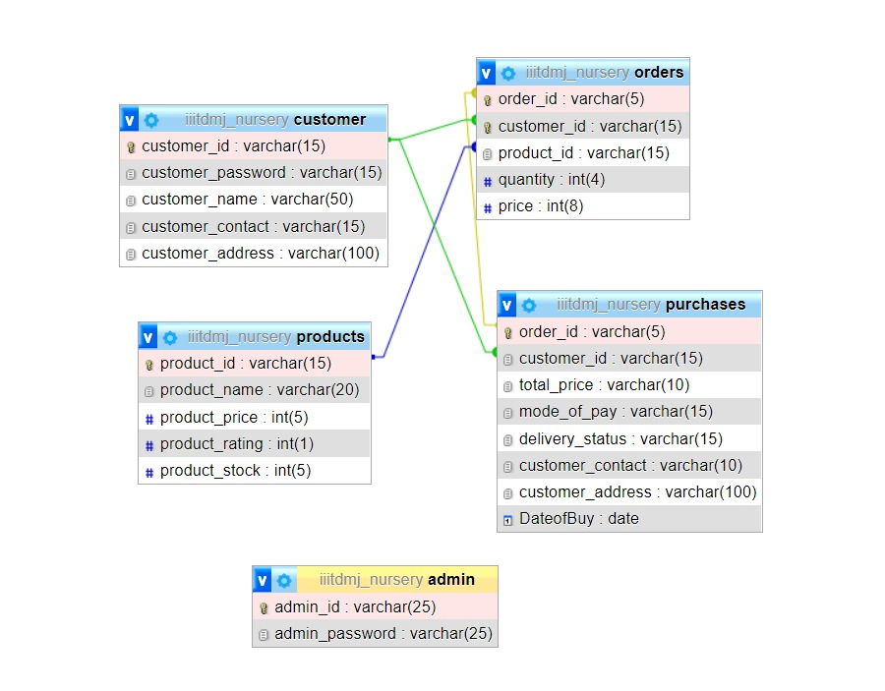
RELATIONAL MODEL :

Slide 7

CHATBOT :
The speciality of our website is we have assured a
24/7 support online chatbot assistance for clarifying the
queries regarding plants, their care and delivery.
For the chat bot we used the google dialogue flow, there
we can add intents and respective answers for those
intents so that when ever user enters the question, the
dialogue flow automatically checks which intent is belong
to that question and gives the answer which we gave at the
time of building.

Slide 8
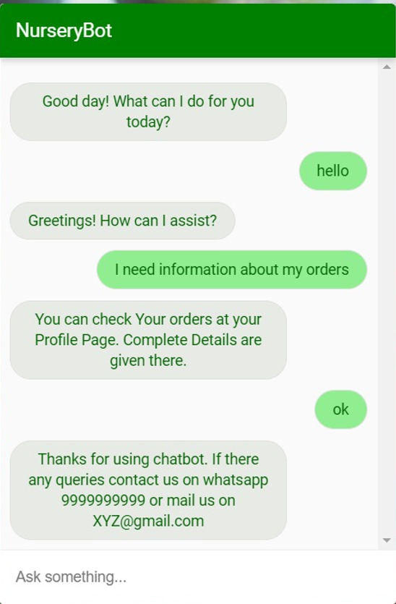
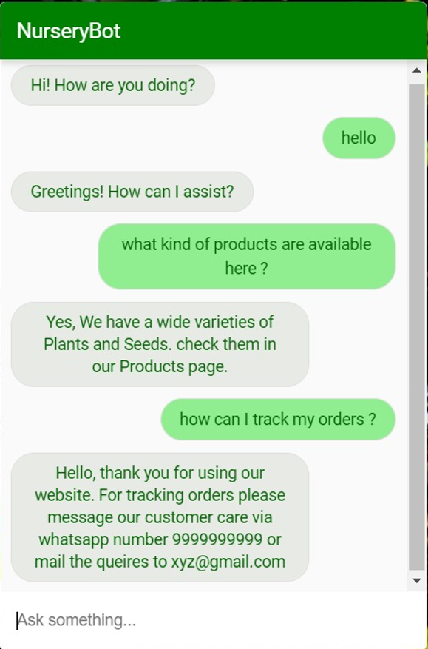
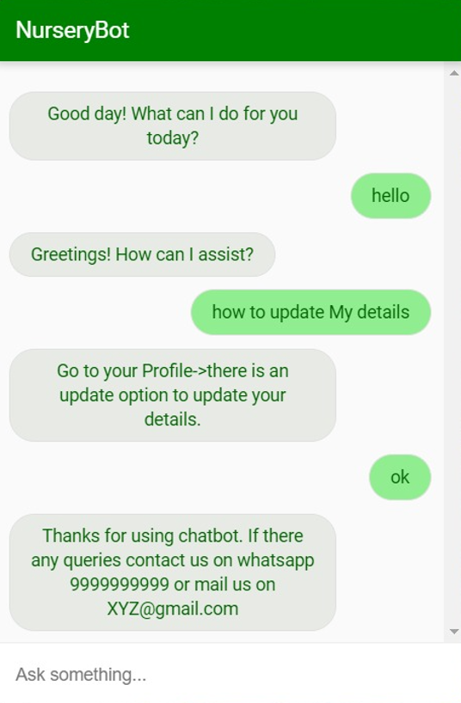
CHATBOT :

Slide 9
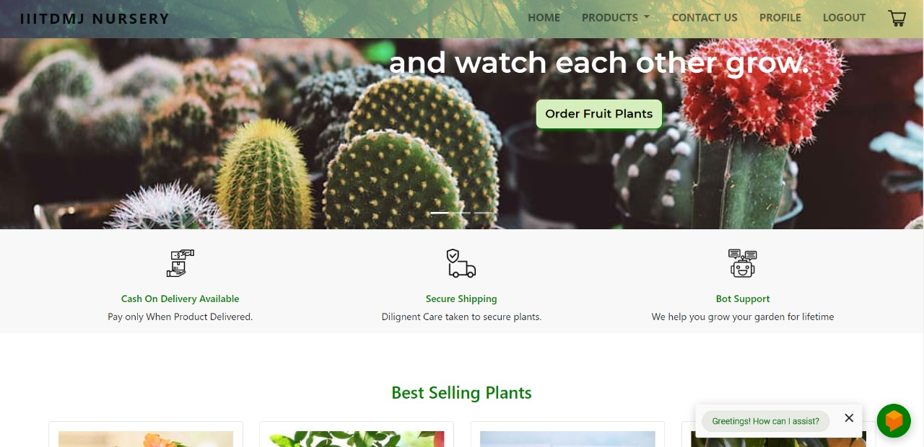
THE MAIN PAGE :

Slide 10
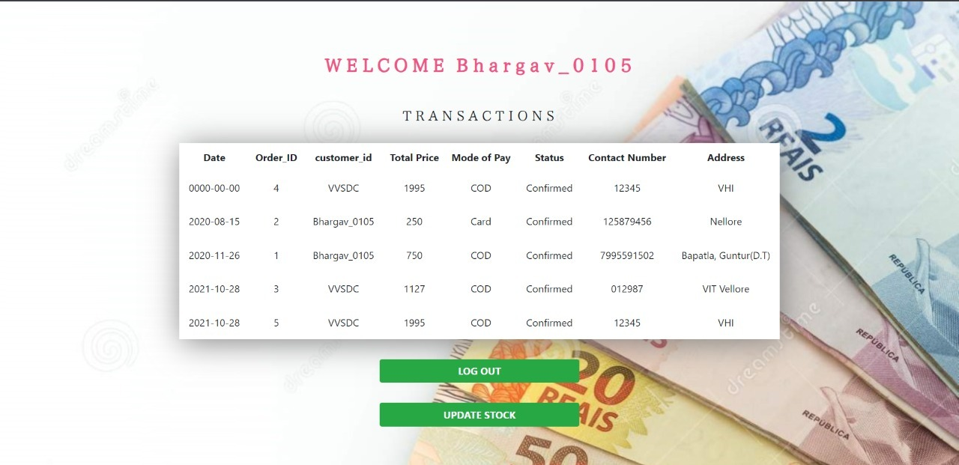
ADMIN INTERFACE :

Slide 11
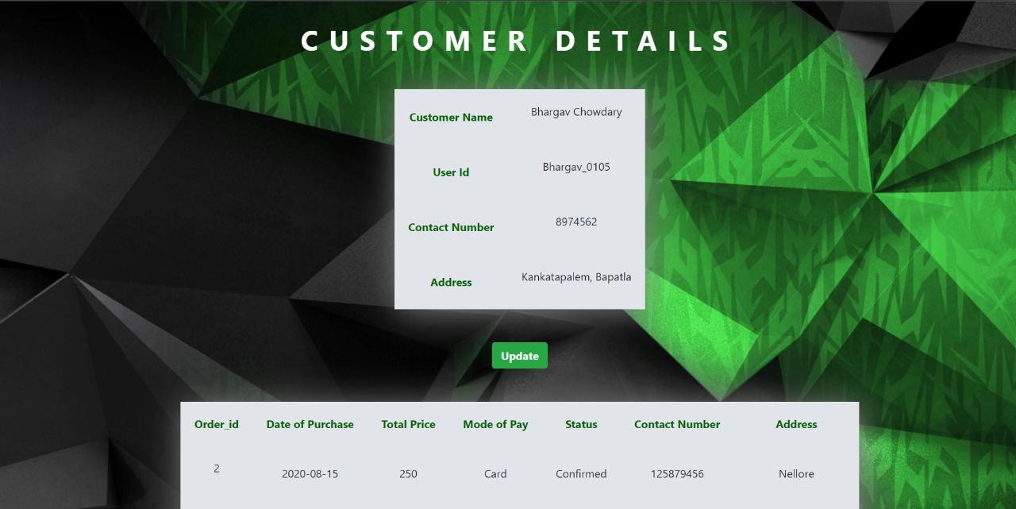
PROFILE AND ORDERS :

Slide 12
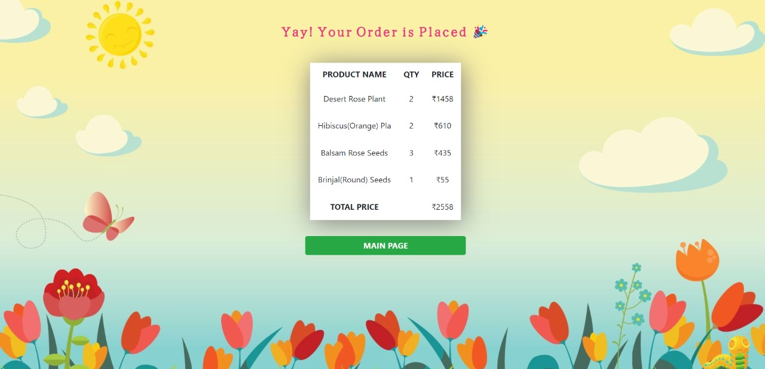

Slide 13

THANK
YOU

